Slide 1

Copyright © 2010 Pearson Education, Inc. Publishing as Prentice Hall
10–<number>

Slide 2

Self-managed teams
Decentralized decision making
Training programs to develop knowledge, skills, and abilities
Flexible job assignments
Open communication
Performance-based compensation
Staffing based on person–job and person–organization fit
10–<number>

Slide 3

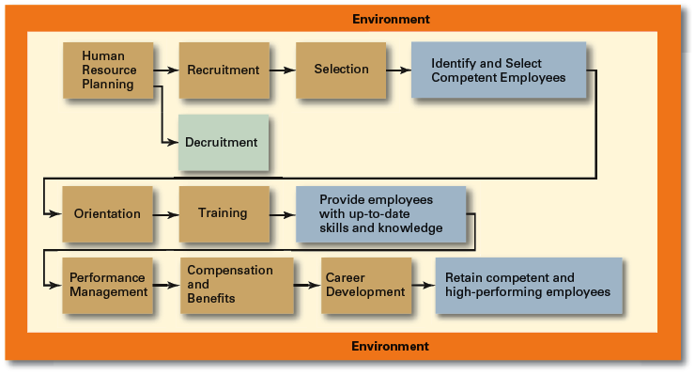
Copyright © 2010 Pearson Education, Inc. Publishing as Prentice Hall
10–<number>

Slide 4

Employee Labor Unions
Governmental Laws and Regulations
  Limit managerial discretion in hiring, promoting, and discharging employees.
    Affirmative Action: Organizational programs that enhance the status of members of protected groups.
Copyright © 2010 Pearson Education, Inc. Publishing as Prentice Hall
10–<number>

Slide 5

  The process by which managers ensure that they have the right number and kinds of people in the right places, and at the right times, who are capable of effectively and efficiently performing their tasks.
  Steps in HR planning:
    1) Assessing current human resources
    2) Assessing future needs for human resources
Copyright © 2010 Pearson Education, Inc. Publishing as Prentice Hall
10–<number>

Slide 6
Current Assessment
Human Resource Inventory
  A review of the current make-up of the organization’s current resource status.
  Job Analysis
    An assessment that defines a job and the behaviors necessary to perform the job.
    Requires conducting interviews, engaging in direct observation, and collecting the self-reports of employees and their managers.
Copyright © 2010 Pearson Education, Inc. Publishing as Prentice Hall
10–<number>

Slide 7
Current Assessment (cont’d)
Job Description
  A written statement that describes a job.
Job Specification
  A written statement of the minimum qualifications that a person must possess to perform a given job successfully.
Copyright © 2010 Pearson Education, Inc. Publishing as Prentice Hall
10–<number>

Slide 8
Meeting Future Human Resource Needs
Supply of Employees
Demand for Employees
Factors Affecting Staffing
Strategic Goals
Forecast demand for products and services
Availability of knowledge, skills, and abilities
Copyright © 2010 Pearson Education, Inc. Publishing as Prentice Hall
10–<number>

Slide 9

Copyright © 2010 Pearson Education, Inc. Publishing as Prentice Hall
10–<number>

Slide 10
1) Recruitment and Decruitment
Recruitment
  The process of locating, identifying, and attracting capable applicants to an organization
Decruitment
  The process of reducing a surplus of employees in the workforce of an organization
Online Recruiting
  Recruitment of employees through the Internet
    Organizational Web sites
    Online recruiters
Copyright © 2010 Pearson Education, Inc. Publishing as Prentice Hall
10–<number>

Slide 11
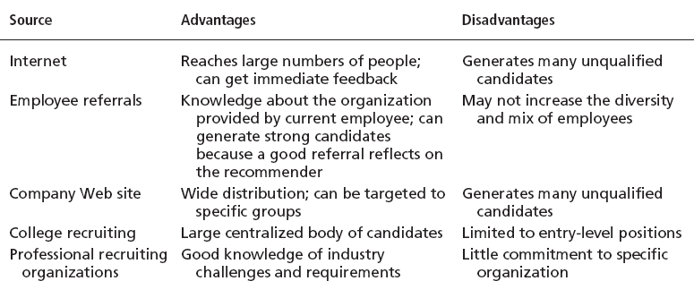
Exhibit 10–4 Major Sources—Recruitment
Copyright © 2010 Pearson Education, Inc. Publishing as Prentice Hall
10–<number>

Slide 12
2) Selection
Selection Process
  The process of screening job applicants to ensure that the most appropriate candidates are hired.
Copyright © 2010 Pearson Education, Inc. Publishing as Prentice Hall
10–<number>

Slide 13

Exhibit 10–7 Selection Tools
Application Forms
Written Tests
Performance Simulations Tests
Interviews
Background Investigations
Physical Examinations
Copyright © 2010 Pearson Education, Inc. Publishing as Prentice Hall
10–<number>

Slide 14
3) Orientation and Training
Orientation
  Education that introduces a new employee to his or her job and the organization.
    Work unit orientation
    Organization orientation
Employee Training
  Types of training
  Training Methods
Copyright © 2010 Pearson Education, Inc. Publishing as Prentice Hall
10–<number>

Slide 15
Exhibit 10–8 Types of Training
Type | Includes
General | Communication skills, computer systems application and programming, customer service, executive development, management skills and development, personal growth, sales, supervisory skills, and technological skills and knowledge
Specific | Basic life/work skills, creativity, customer education, diversity/cultural awareness, remedial writing, managing change, leadership, product knowledge, public speaking/presentation skills, safety, ethics, sexual harassment, team building, wellness, and others
Copyright © 2010 Pearson Education, Inc. Publishing as Prentice Hall
10–<number>
Source: Based on “2005 Industry Report—Types of Training,” Training, December 2005, p. 22.

Slide 16
Exhibit 10–9 Training Methods
Traditional
Training Methods
  On-the-job
  Job rotation
  Mentoring and coaching
  Experiential exercises
  Workbooks/manuals
  Classroom lectures
Technology-Based Training Methods
  CD-ROM/DVD/videotapes/ audiotapes
  Videoconferencing/ teleconferencing/
  satellite TV
  E-learning
Copyright © 2010 Pearson Education, Inc. Publishing as Prentice Hall
10–<number>

Slide 17

4) Employee Performance Management
Performance Management System
  A process of establishing performance standards and appraising employee performance.
Copyright © 2010 Pearson Education, Inc. Publishing as Prentice Hall
10–<number>

Slide 18
Exhibit 10–10 Advantages and Disadvantages of Performance
Appraisal Methods
Method | Advantage | Disadvantage
Written essays | Simple to use | More a measure of evaluator’s writing ability than of employee’s actual performance
Critical incidents | Rich examples; behaviorally based | Time-consuming; lack quantification
Graphic rating scales | Provide quantitative data; less time-consuming than others | Do not provide depth of job behavior assessed
BARS | Focus on specific and measurable job behaviors | Time-consuming; difficult to develop
Multiperson comparisons | Compares employees with one another | Unwieldy with large number of employees; legal concerns
MBO | Focuses on end goals; results oriented | Time-consuming
360-degree appraisals | Thorough | Time-consuming
Copyright © 2010 Pearson Education, Inc. Publishing as Prentice Hall
10–<number>

Slide 19
5) Compensation and Benefits
Types of Compensation
  Base wage or salary
  Wage and salary add-ons
  Incentive payments
  Skill-based pay
Copyright © 2010 Pearson Education, Inc. Publishing as Prentice Hall
10–<number>

Slide 20

Copyright © 2010 Pearson Education, Inc. Publishing as Prentice Hall
10–<number>

Slide 21

10–<number>

Slide 22
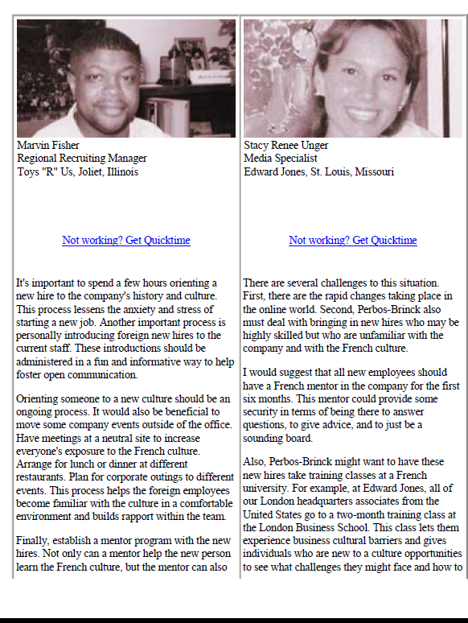
Copyright © 2010 Pearson Education, Inc. Publishing as Prentice Hall
10–<number>

Slide 23

Managing Downsizing
Managing Workforce Diversity
Copyright © 2010 Pearson Education, Inc. Publishing as Prentice Hall
10–<number>

